Slide 1
Influence 360
Created by Alex Short PCS Producer | Miami, FL

Slide 2

INFLUENCE 360
Decoding the Ecosystem.
A structured knowledge graph mapping every relationship that shapes a yacht ownership journey — from day zero to the final sale.

Slide 3

INFLUENCE 360 — FRAMEWORK STRICTLY CONFIDENTIAL
The UHNW ecosystem is opaque. Influence 360 identifies decision-drivers versus passive advisors to find actionable beach heads.
THE REALITY
Not Everyone Is Equal.
In high-stakes yacht transactions, influence is rarely linear. Titles are fundamentally misleading.
The true power nodes—those who dictate operational realities, influence vessel optionality, and sign off on major expenditures—are often hidden behind corporate structures or offshore family offices.
The Solution
We mapped the entire stakeholder landscape into a relational database. By assigning specific metrics to every role, we mathematically rank absolute influence over a deal.
This filters out the noise, allowing us to focus precisely on the key targets required for closing.
Prepared for Executive Review
02

Slide 4

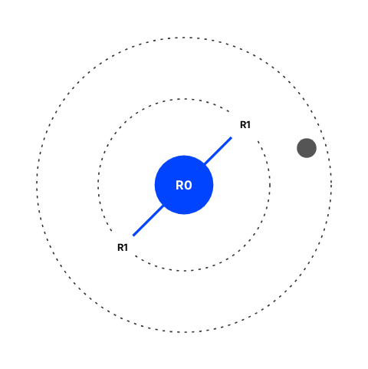
INFLUENCE 360 — VISUALIZATION STRICTLY CONFIDENTIAL
Visual representation in the UI correlates directly to real-world power and proximity to the principal.
GRAPH MECHANICS
■
Node Proximity (Decision Distance): The closer a node is to the center (Ring 0), the fewer "hops" it is to the Principal. Proximity dictates access.
■
Node Radius (Overall Score): A larger radius reflects a higher influence score. This composite metric combines the weight of their decisions and contact frequency with decision-makers.
■
Interconnectivity: Lines detail exactly who talks to whom, why they talk, and what information flows between them.
■
Role Context: Every node contains a description of that role's "life" and duties within a transaction.
Prepared for Executive Review
03

Slide 5


INFLUENCE 360 — TARGETING STRICTLY CONFIDENTIAL
Dynamic filtration isolates the exact roles required based on the specific parameters of the deal.
FILTRATION CAPABILITIES
Vessel Optionality
Conflict & Signatory
Custom Thresholds
Role relevance scales drastically with the boat. The ecosystem for a 24m yacht is vastly different than a 100m gigayacht.
We filter by actionable authority. Can they sign the Certificate of Insurance? Are they conditional to a transaction?
By adjusting parameters for "Contact Frequency" and "COI Weight," we instantly isolate stakeholders who hold severe influence and meet with the decision-maker regularly.
The graph intelligently filters roles in or out based on the target vessel size.
We strip away operational noise to find the legal gatekeepers.
Prepared for Executive Review
04

Slide 6




INFLUENCE 360 — LIFECYCLE STRICTLY CONFIDENTIAL
Mapping stakeholder relevance is not static; it spans the entire 7-10 year lifespan of the asset.
THE JOURNEY
Day 0: Conception
Acquisition & Build
Operations (Y1-Y8)
Exit & Disposition
The UHNW decides to purchase. Family offices, wealth managers, and buyer's brokers dictate the initial brief and financing structure.
Maritime lawyers, central agents, surveyors, and shipyard commercial managers handle the heavy transaction and diligence phase.
The daily reality. Captains, management companies, DPAs, and purser/crew networks sustain the asset and manage ongoing risk.
Refit yards prep the vessel, escrow agents align, and sales brokers retake the center stage to offload the asset.
Prepared for Executive Review
05

